Slide 1
MACHINE LEARNING ALGORITHMS
UNIT – V

Slide 2
Introduction to Machine Learning
Machine Learning is a branch of Artificial Intelligence.
Machine Learning (ML) allows systems to automatically learn patterns from data and improve their performance over time.
ML algorithms are mainly categorized into:
Supervised Learning – Uses labeled data
Unsupervised Learning – Uses unlabeled data
Reinforcement Learning – Learns through rewards and penalties

Slide 3
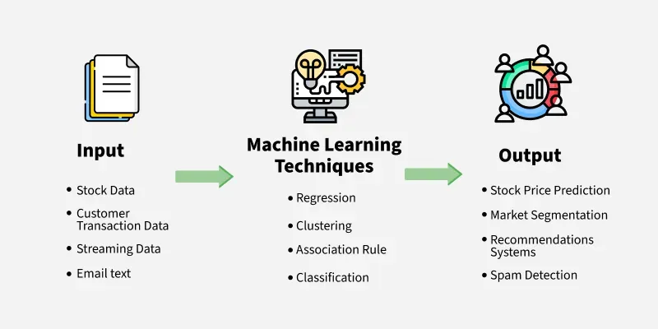

Slide 4
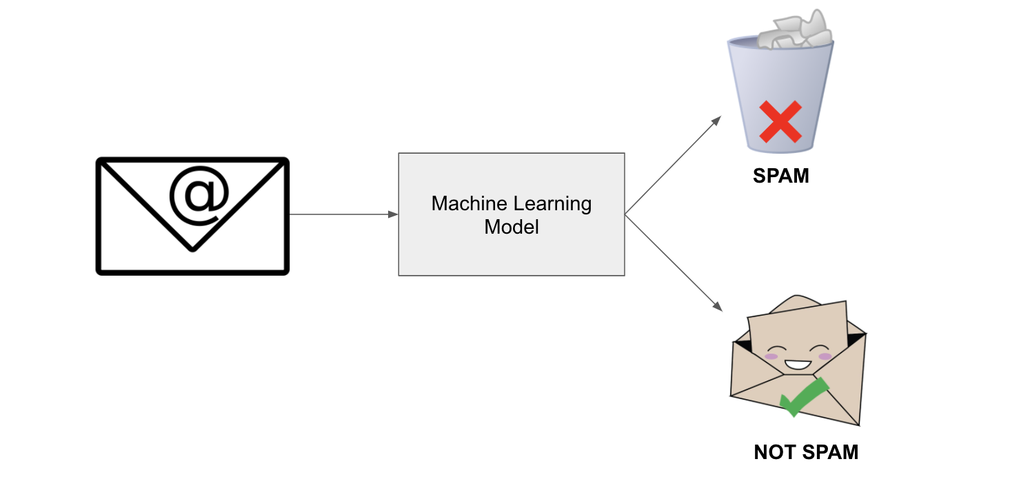
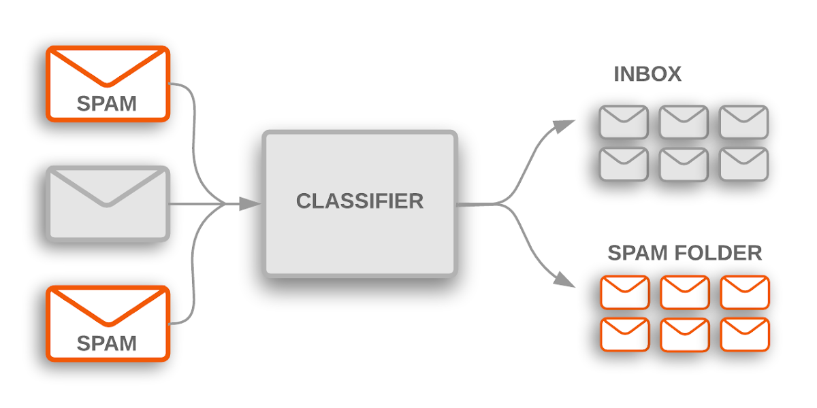
Classification
Classification is a supervised learning technique in which data is categorized into predefined classes or labels.
It is commonly used in spam detection, medical diagnosis, and customer classification.

Slide 5
Example: Email Spam Detection
Emails are classified into two categories:
  Spam
  Not Spam
A machine learning classification model learns from past labeled emails and predicts whether a new email is spam based on words, sender details, and links.
Used In: Gmail, Outlook, Yahoo Mail

Slide 6
Support Vector Machines (SVM)
Support Vector Machine is a powerful classification algorithm used to separate data into different classes by finding an optimal hyperplane.
Key Features:
Works well with high-dimensional data
Effective when the number of features is greater than the number of samples
Uses kernel functions for non-linear classification
Applications:
Face recognition
Text classification
Bioinformatics

Slide 7
Example: Face Recognition System
SVM is used to separate faces of different individuals by drawing an optimal boundary between facial features.
Each person’s face data forms a class
SVM finds the best separating hyperplane
Used In: Mobile phone face unlock, security systems, surveillance cameras

Slide 8
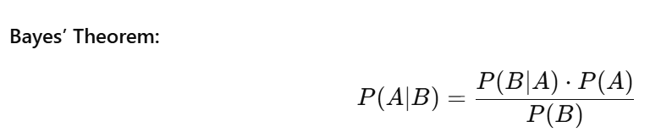
Naive Bayes Classifier
Naive Bayes is a probabilistic classifier based on Bayes’ Theorem with the assumption that features are independent.

Slide 9
Advantages:
Simple and fast
Works well with large datasets
Requires less training data
Applications:
Spam email filtering
Sentiment analysis
Document classification

Slide 10
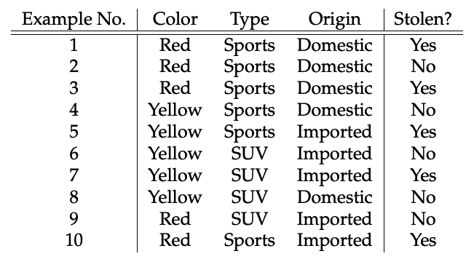
Example
Consider the Dataset:

Slide 11
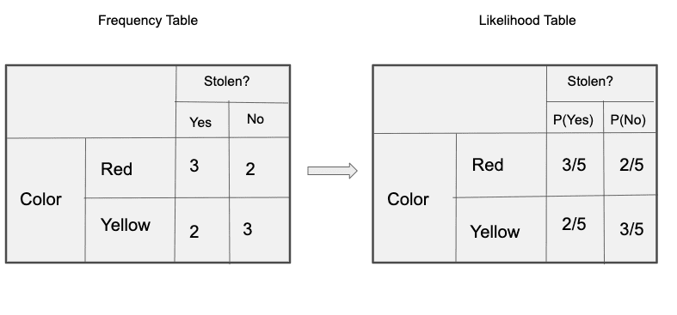

Slide 12
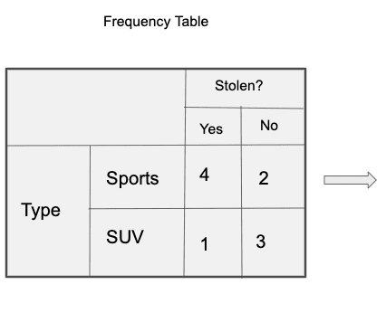

Likelihood Table

Slide 13
Frequency Table for Origin
Likelihood Table for Origin

Slide 14


we can calculate the posterior probability P(Yes | X) as :
P( No | X ):

Slide 15
Since 0.144 > 0.048, Which means given the features RED SUV and Domestic, our example gets classified as ’NO’ the car is not stolen.

Slide 16
Example: SMS and Email Spam Filtering
Naive Bayes calculates the probability of a message being spam based on the words used.
Words like “free”, “win”, “offer” increase spam probability
Very fast and efficient
Used In: Email filtering systems, text classification, sentiment analysis

Slide 17
Decision Trees
A Decision Tree is a supervised learning algorithm that uses a tree-like structure to make decisions.
Components of Decision Tree:
Root Node – Represents the entire dataset
Decision Nodes – Represent feature-based decisions
Leaf Nodes – Represent final output or class

Slide 18
Advantages:
Easy to understand and interpret
Handles both numerical and categorical data
Requires little data preprocessing
Applications:
Credit risk analysis
Customer segmentation
Medical diagnosis

Slide 19
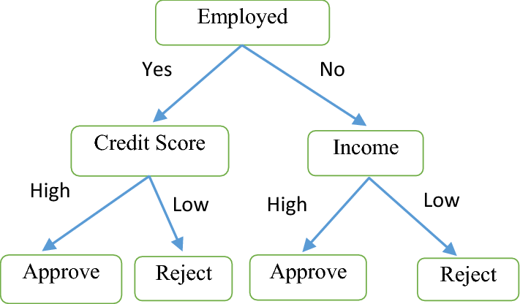
Example: Loan Approval System
Banks use Decision Trees to decide whether to approve a loan.
Decision Conditions:
Income level
Credit score
Employment status
Each decision is represented as a branch in the tree.
Used In: Banking, insurance, customer risk assessment

Slide 20
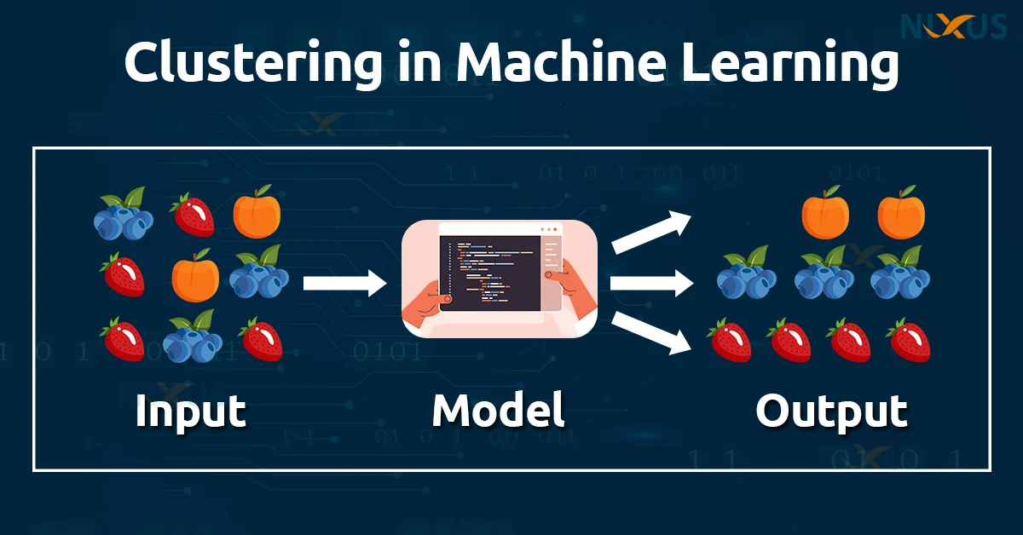
Clustering
Clustering is an unsupervised learning technique that groups similar data points into clusters without using labeled data.

Slide 21
Example: Customer Segmentation
Companies group customers based on:
Buying behavior
Age
Location
Spending patterns
No predefined labels are given.
Used In: Marketing campaigns, personalized offers, e-commerce platforms

Slide 22
K-Means Clustering
K-Means is one of the most popular clustering algorithms.
Working Steps:
Choose the number of clusters (K)
Randomly initialize centroids
Assign each data point to the nearest centroid
Recalculate centroids
Repeat until convergence

Slide 23
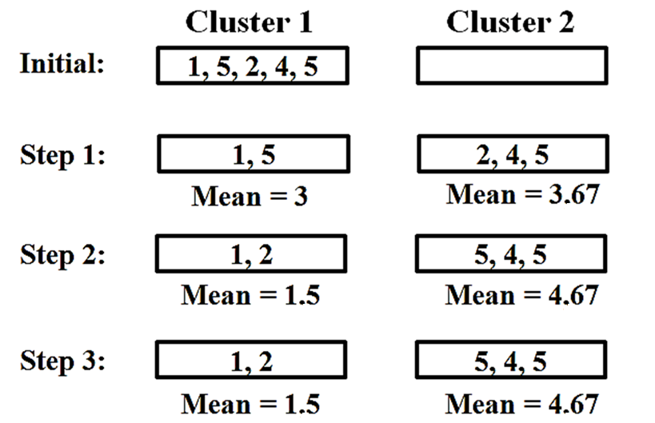

Slide 24
Advantages:
Simple and efficient
Works well for large datasets
Applications:
Market segmentation
Image compression
Customer behavior analysis

Slide 25
Example
You are given a dataset containing monthly electricity usage (in kWh) of several households.
Household | Monthly Electricity Usage (kWh)
H1 | 420
H2 | 130
H3 | 440
H4 | 120
H5 | 450
H6 | 125

Slide 26
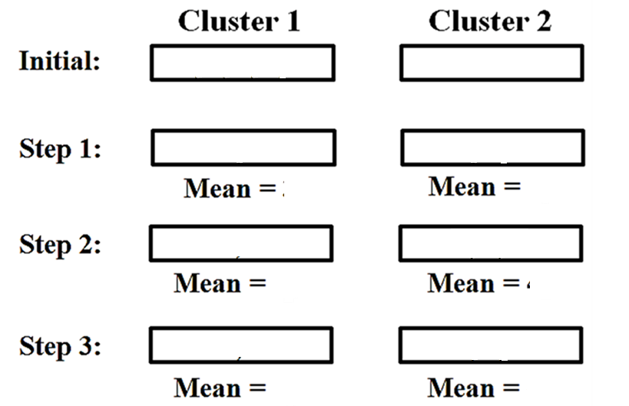
Expected Outcome
One cluster representing low electricity usage households
One cluster representing high electricity usage households

Slide 27
Example: Market Segmentation
A retail company groups customers into clusters such as:
High-value customers
Medium-value customers
Low-value customers
K-Means automatically creates clusters based on similarity.
Used In: Amazon, Flipkart, Netflix recommendations

Slide 28
Example
Imagine you have 6 students and you only know their height.
You want to group them into 2 groups, but you don’t know the groups beforehand.
Student | Height
A | 150
B | 152
C | 155
D | 170
E | 172
F | 175

Slide 29
K-Means will:
Pick 2 random centers
Assign each student to the nearest center
Move the centers to the average of the group
Repeat until groups stop changing
Result:
Group 1 → Short students
Group 2 → Tall students
👉 No labels were given, K-Means found patterns by itself.

Slide 30
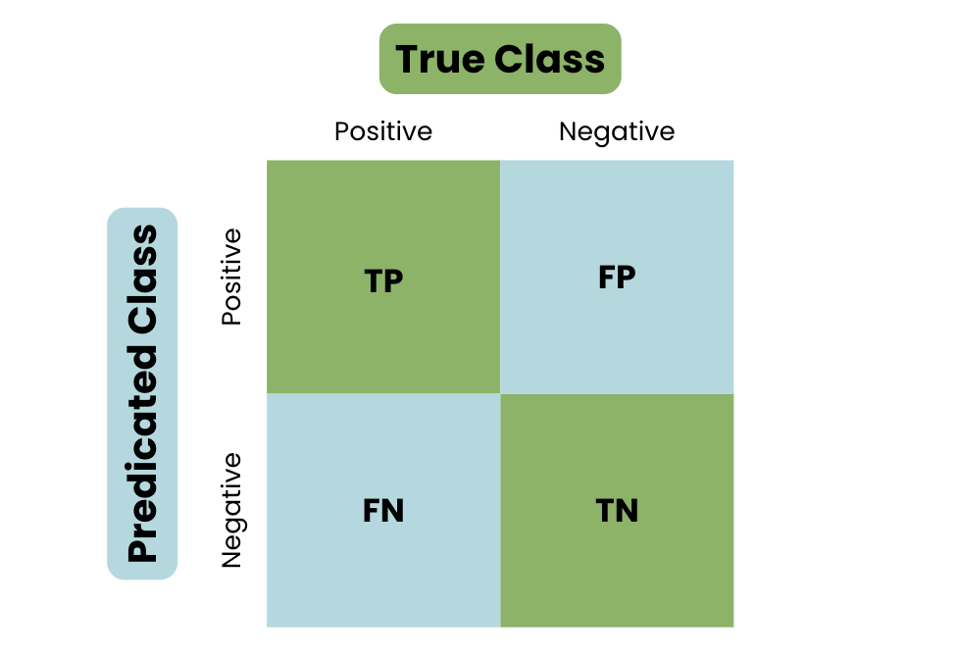
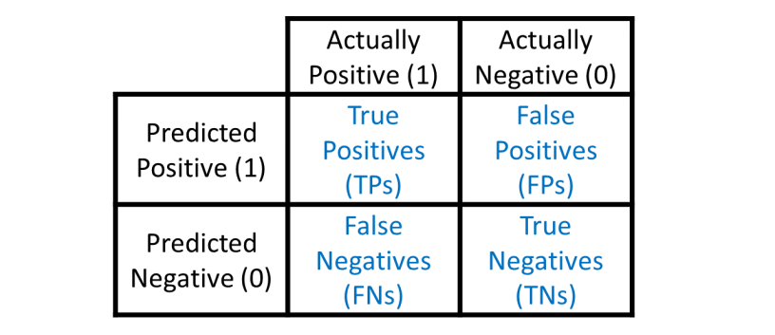
Confusion Matrix
A Confusion Matrix is a performance evaluation tool for classification models.
Structure of Confusion Matrix:

Slide 31
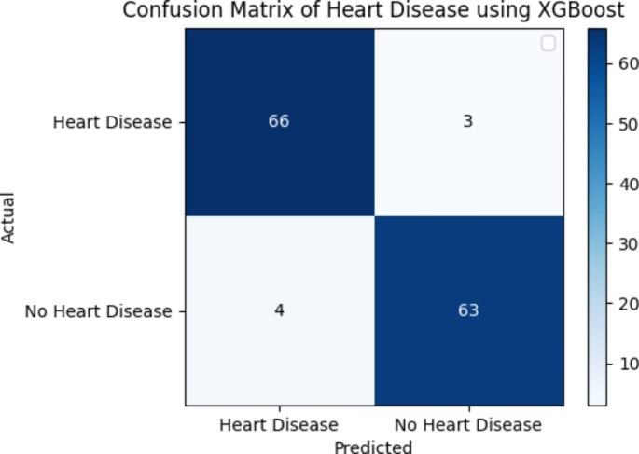
Example: Medical Disease Diagnosis
A confusion matrix evaluates how well a model predicts disease.
Helps doctors understand errors and improve diagnosis accuracy.
Used In: Healthcare, medical testing, diagnostic systems

Slide 32


Performance Metrics:
Accuracy = (TP + TN) / Total
Precision = TP / (TP + FP)
Recall = TP / (TP + FN)
F1-Score = Harmonic mean of Precision and Recall
We can calculate these:
TPR – True Positive Rate,
FPR – False Positive Rate,
FNR – False Negative Rate,
TNR – True Negative Rate.

